Slide 1

Python First Program

Slide 2
INDEX
Execute a Python program
First program: printing a line of Text
Modifying your program
General syntax of Python coding
Display single line of text with multiple statements
Display multiple line of text with single statements using Escape sequence
Second program: Adding integers
String and formatting
Arithmetic operators
Relational operators
Logical operators
Bitwise operators
Keywords

Slide 3
EXECUTE A PYTHON PROGRAM
Type your python code into a file and save as any name with extension “.py”.
        To run it type python fileName.py
Execute code
    Type python in the command line
    Runs the python interpreter with your python file.

Slide 4
FIRST PROGRAM: PRINTING A LINE OF TEXT
1 # Fig. 2.1: fig02_01.py
2 # Printing a line of text in Python.
3
4 print "Welcome to Python!"
This is a comment
Prints out the line of text
Welcome to Python!

Slide 5
FIRST PROGRAM IN INTERACTIVE MODE
We can run any python statement in interactive mode.
Interactive mode will be initiated by running python interpreter alone
Python 2.2b2 (#26, Nov 16 2001, 11:44:11) [MSC 32 bit (Intel)] on win32
Type "help", "copyright", "credits" or "license" for more information­.
>>> print "Welcome to Python!"
Welcome to Python!
>>> ^Z

Slide 6
MODIFYING YOUR PROGRAM
Python comes up with Editor called IDLE to create, edit a Python file and you can your program from IDLE itself.
You can use any other editor to modify your python file at your own wish.

Slide 7
GENERAL SYNTAX OF PYTHON CODING
  The # symbol used to denote a single line comment
  The print function used to send a stream of text to be output to the user
  Indentation
    Indentation is used to delimit code
    Python does not use {} to enclose a multi-line statement
    There is no exact rule for the number of spaces but they are generally in groups of four
  Python uses no end of statement character, therefore a new line of code is determined by return space.
  Use blank lines between functions, space between operators.

Slide 8
DISPLAY SINGLE LINE OF TEXT WITH MULTIPLE STATEMENTS
Printing Lines of Text
  Python displays each print function on a new line
  The comma can be used to tell the compiler to make a space rather than a white line
1 # Fig. 2.4: fig02_04.py
2 # Printing a line with multiple statements.
3
4 print "Welcome",
5 print "to Python!"
The comma tells the compiler to insert a space rather than go to the next line
Welcome to Python!

Slide 9
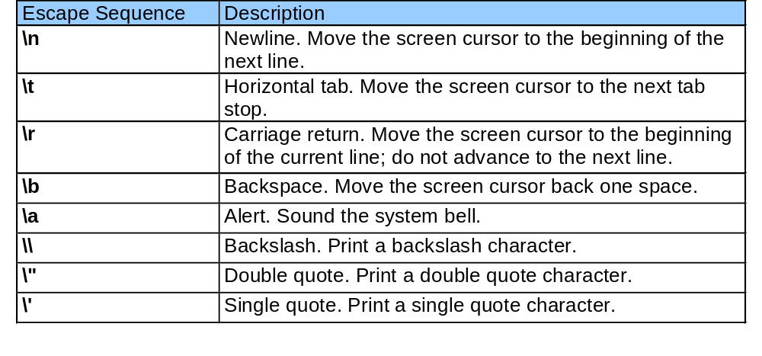
ESCAPE SEQUENCE
  Used to perform a different task that normally intended

Slide 10
DISPLAYING MULTIPLE LINES OF TEXT USING SINGLE STATEMENT
1 # Fig. 2.5: fig02_05.py
2 # Printing multiple lines with a single statement.
3
4 print "Welcome\nto\n\nPython!"
The \n is used to make the text appear on the next line
Welcome
To
Python!

Slide 11
SECOND PROGRAM: ADDING INTEGERS
Functions
  The raw_input function
    Used to retrieve data from the user
  The int function
    Used to convert strings to integers

Slide 12
SECOND PROGRAM: ADDING INTEGERS
1 # Fig. 2.7: fig02_07.py
2 # Simple addition program.
3
4 # prompt user for input
5 integer1 = raw_input( "Enter first integer:\n" ) # read string
6 integer1 = int( integer1 ) # convert string to integer
7
8 integer2 = raw_input( "Enter second integer:\n" ) # read string
9 integer2 = int( integer2 ) # convert string to integer
10
11 sum = integer1 + integer2 # compute and assign sum
12
13 print "Sum is", sum # print sum
Prompts the user to enter and integer value
Converts the string value into an integer value
Adds up and then prints out the sum of the two numbers
Enter first integer:
45
Enter second integer:
72
Sum is 117

Slide 13
SECOND PROGRAM: ADDING INTEGERS
  Adding Integers using interactive window
Python 2.2b2 (#26, Nov 16 2001, 11:44:11) [MSC 32 bit (Intel)] on win32
Type "help", "copyright", "credits" or "license" for more information.
>>> value1 = int(raw_input( "Enter an integer: " ))
Enter an integer: 2
>>> value2 = int(raw_input( "Enter an integer: " ))
Enter an integer: 4
>>> print value1 + value2
6

Slide 14
ARITHMETIC OPERATORS
Symbols
  + = Add
  - = Subtract
  * = Multiply
  / = Divide
  % = Modulus or Reminder
  ** = Exponential
  // = Floor division

Slide 15
ARITHMETIC OPERATORS
Python 2.2b2 (#26, Nov 16 2001, 11:44:11) [MSC 32 bit (Intel)] on win32
Type "help", "copyright", "credits" or "license" for more information.
>>> 3 / 4 # floor division (default behavior)
0
>>> 3.0 / 4.0 # true division (floating-point operands)
0.75
>>> 3 // 4 # floor division (only behavior)
0
>>> 3.0 // 4.0 # floating-point floor division
0.0
>>> from __future__ import division
>>> 3 / 4 # true division (new behavior)
0.75
>>> 3.0 / 4.0 # true division (same as before)
0.75
The above figure shows the difference in behavior of the / operator.

Slide 16
RELATIONAL OPERATORS
1 # Fig. 2.22: fig02_22.py
2 # Compare integers using if structures, relational operators
3 # and equality operators.
4
5 print "Enter two integers, and I will tell you"
6 print "the relationships they satisfy."
7
8 # read first string and convert to integer
9 number1 = raw_input( "Please enter first integer: " )
10 number1 = int( number1 )
11
12 # read second string and convert to integer
13 number2 = raw_input( "Please enter second integer: " )
14 number2 = int( number2 )
15
16 if number1 == number2:
17 print "%d is equal to %d" % ( number1, number2 )
18
19 if number1 != number2:
20 print "%d is not equal to %d" % ( number1, number2 )
21
Gets two values from the user and converts them to strings

Slide 17
RELATIONAL OPERATORS
22 if number1 < number2:
23 print "%d is less than %d" % ( number1, number2 )
24
25 if number1 > number2:
26 print "%d is greater than %d" % ( number1, number2 )
27
28 if number1 <= number2:
29 print "%d is less than or equal to %d" % ( number1, number2 )
30
31 if number1 >= number2:
32 print "%d is greater than or equal to %d" % ( number1, number2 )
Checks each of the rational operators or the numbers using if statements.

Slide 18
RELATIONAL OPERATORS
Enter two integers, and I will tell you
the relationships they satisfy.
Please enter first integer: 37
Please enter second integer: 42
37 is not equal to 42
37 is less than 42
37 is less than or equal to 42
Enter two integers, and I will tell you
the relationships they satisfy.
Please enter first integer: 54
Please enter second integer: 17
54 is not equal to 17
54 is greater than 17
54 is greater than or equal to 17

Slide 19
LOGICAL OPERATORS
Symbols
  and → Evaluates to true if both expressions are true
  or → Evaluates to true if at least one expression is true
1 # check the mark in invalid
2
if marks < 0 or marks > 100:
print “Invalid marks\n”
# check the grade
if marks > 79 and marks <= 100:
print “First class with distinction\n”
Checking mark is valid using OR operator
Checking grade using AND operator

Slide 20
ASSIGNMENT OPERATORS
Symbols
  = → Assignment operator
  += → Addition assignment
  -= → Subtraction assignment
  *= → Multiplication assignment
  /= → Division assignment
1 # assignment operators
2
total_marks = 0
marks = [ 75, 65, 55 ]
for i in marks:
total_marks += i
print “Total Marks: %d\n” % (total_marks)
Normal assignment operator
Assignment operation

Slide 21
OTHER OPERATORS
    not → Returns true if the expression is false
    in → Check the value available in the list. Also used with for loop to process the elements.
1 # assignment operators
2
total_marks = 0
marks = [ 75, 65, 55 ]
for i in marks:
total_marks += i
if not total_marks:
print “Total Marks: %d\n” % (total_marks)
“in” operator to iterate it.
“not” operator used here to check to check the total_marks has some value.

Slide 22
BITWISE OPERATORS
Symbols
  Bitwise and ( & )
  Bitwise or ( | )
1 # bitwise operators
2
variable1 = 2
if variable1 & 0x01:
print “Values should be odd number”
if variable1 | 0x01:
print “Values changed to odd number”

Slide 23
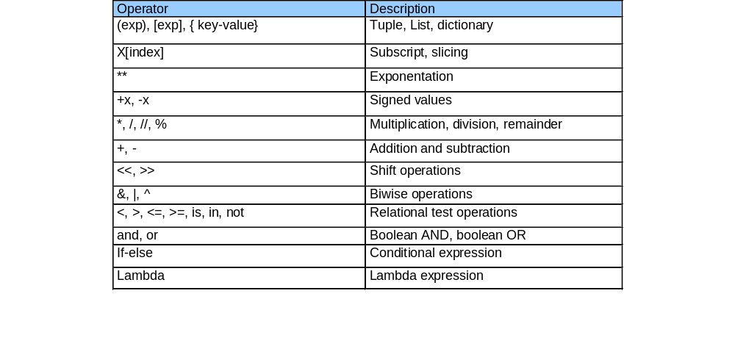
OPERATOR PRECEDENCE
Precedence used to separate the order of operation if more than one operator used in same statements.
The below table summarize the operator precedence from highest precedence

Slide 24
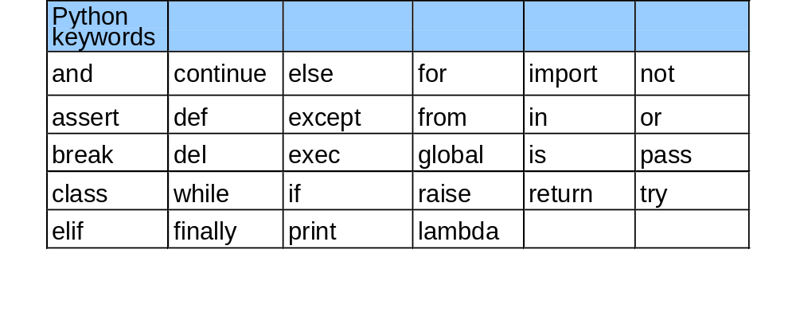
KEYWORDS
Keywords are reserved words in Python and it will be treated to specified functionality by interpreter.
Some of the keywords are below

